Slide 1
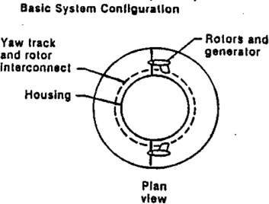
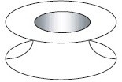
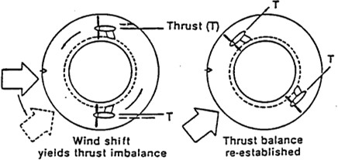
Toroidal Rotor Amplifier Platform (TARP)

Slide 2
Toroidal Rotor Amplifier Platform (TARP)
Toroidal Accelerator Rotor Platform (TARP) is a new technology for the energy generation from wind
TARP combines generation and transmission.
This concept of wind capture is based on the Wind Amplified Rotor Platform (WARP).
Small wind turbines are grouped and installed in modules, to conform to the needs of distributed generation.
This entire platform consists of a determined number of TARPs piled up one on top of another.

Slide 3
Toroidal Rotor Amplifier Platform (TARP)
Toroidal form of aerodynamic turbine shelter characterizes the working principle of the TARP
A twin rotor system of typical diameter 3 m or less are placed 180 apart
Wind accelerates around the shelter, amplifying the density of wind power energy available
Rotors are coupled directly to the generator through a system of brakes but without a speed multiplication gearbox
If the wind changes from direction (a) to direction (b), a torque will form on the rotating wheel shelter that moves until it is balanced in the new wind direction.

Slide 4
Advantages of TARP
Efficient than traditional blade-based wind turbines
Design is quieter, lighter, and easier to maintain than traditional wind turbines
The bladeless design means that there are no large rotating blades, which can be dangerous and noisy
The lack of blades means that the TARP is lighter and easier to install

Slide 5
Wind amplified rotor platform (WARP)
An energy conversion device comprises a stacked array of alternating yaw rotatable and fixed toroidal modules about a central core structure mainly designed to amplify the wind which in turn increases the power
Yawable toroids have typically four impact impellers mounted in their peripheral flow regions for the purpose of capturing flow energy.
Static toroids are mounted to complement and further enhance fluid flow impact impeller energy capture
The stacked array of toroids with impellers is termed as Toroidal Rotor Amplified Platform (TRAP), and a toroid without impellers is Toroidal Wind Frame (TWF)
The aggregate used for wind energy conversion is a Wind Amplified Rotor Platform (WARP)
more efficient and use less land than wind machines
WARP rotors are 1-3m in diameter and are directly coupled (without step up gear box) to a generator due to their high RPM

Slide 6
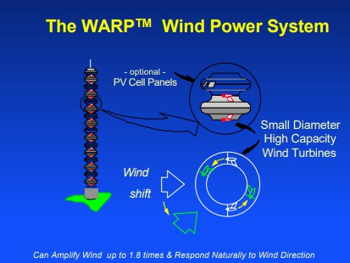
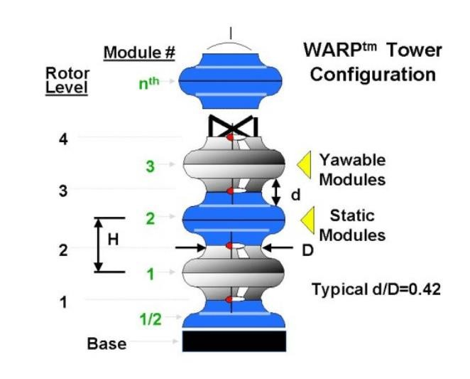
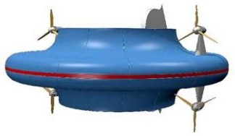
WARP yaw module

Slide 7
Wind amplified rotor platform (WARP)
Advantages
Superior Performance
Easy Operation
Easy Maintenance
Reliability
Needs Little Land Area
Has Less Interference
Disadvantages
High Installation Costs
Not Economically Feasible For Small Power Applications

